Slide 1
Distributed Control and Automation Framework (DCAF)
Static Modules
Benjamin Celis, Mathew Pollock, Simon Perez

Slide 2
Agenda
What is a Dynamic Module
When to use a Static module
Common Overrides
Table API
Exercise Module

Slide 3
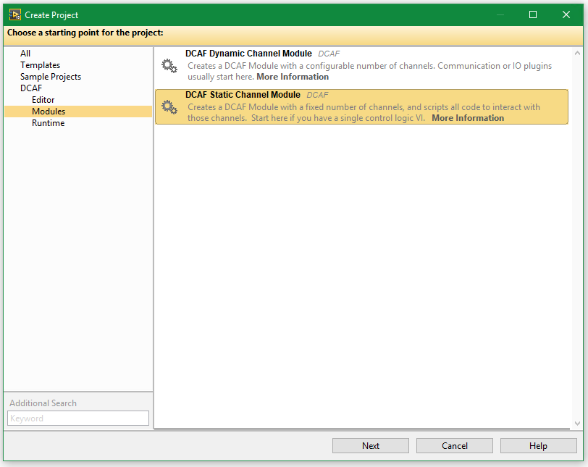
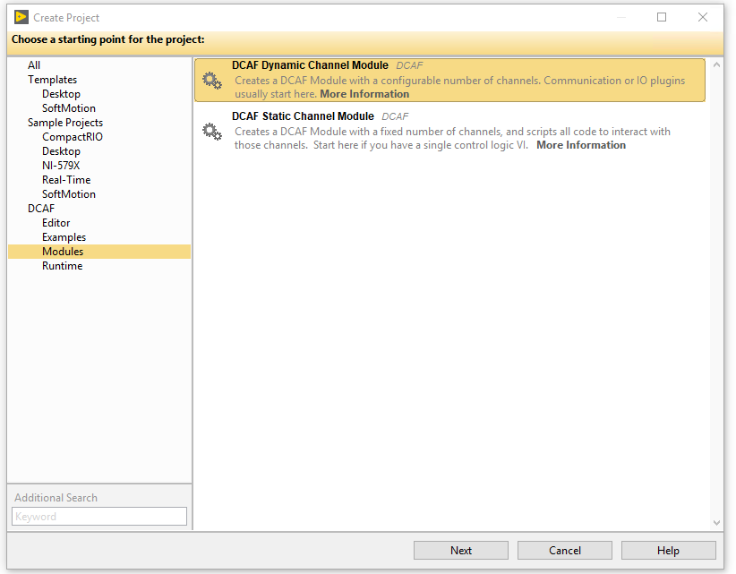
Static Or Dynamic?

Slide 4
Static or Dynamic
Static
Module developer defines the number of channels available in the module
Template includes UI ready to use.
Easier to Create
Mostly used for processing
Dynamic
Final user can configure the number of channels.
More flexible template
Requires more codding.
More cmmonly used for input/output

Slide 5
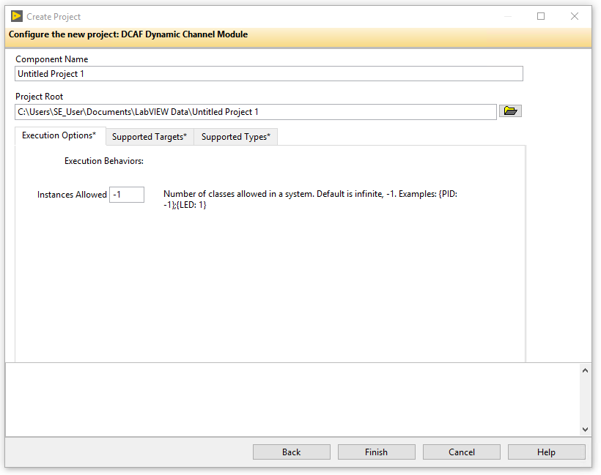
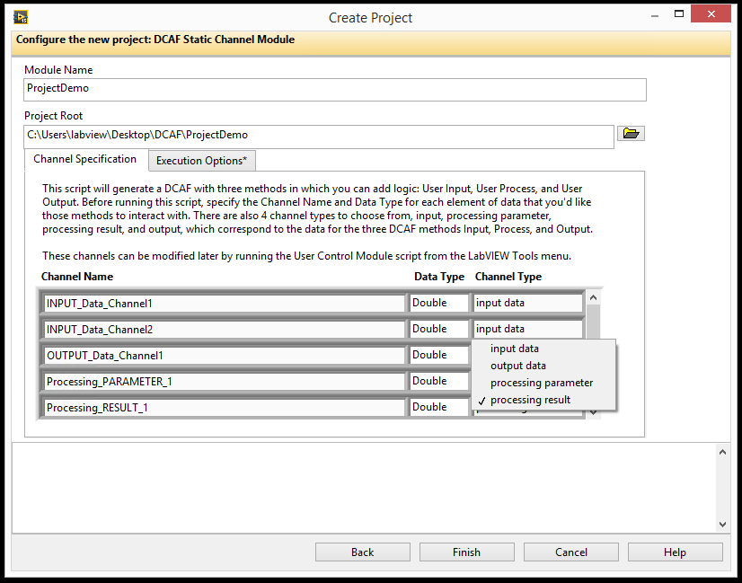
Creating a Dynamic Module
Create Project through Template
Creates 3 main classes:
ModuleName configuration.lvlclass
ModuleName editor.lvlclass
ModuleName runtime.lvlclass

